Slide 1
Project name PILL REMINDER Evaluation Phase 1: Prototype Explanation
Ankita Asthana (18mca8032)
Gudia (18mca8039)
Bhumika Shrestha (17bca1470))
Saugat (17bca1274)
Garvit (18bsc1060)

Slide 2
Content
Introduction
Splash
Login
Forgot Password
Create new Account
Dashboard
MedProfile
Weekly Report
Set date and time
Feedback
Notification
Weekly Report

Slide 3
Introduction
Pill reminder is a an android based application.
It helps you to keep tract of you medicines intake by providing weekly report.
It will reduce time.
The time is set by the user and according to that the notification appears.

Slide 4
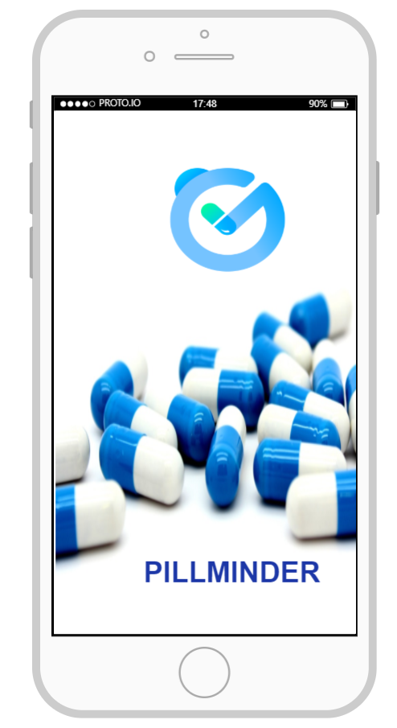
Splash
The very First page which occur when user click on “Pillminder” application icon . After 5 sec it will automatically switch into Login Page.

Slide 5
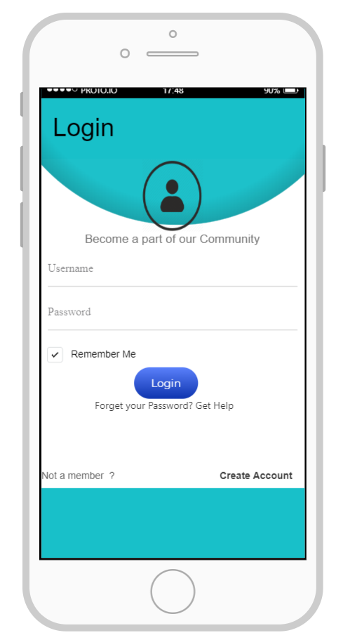
Login
For Existing User

Slide 6
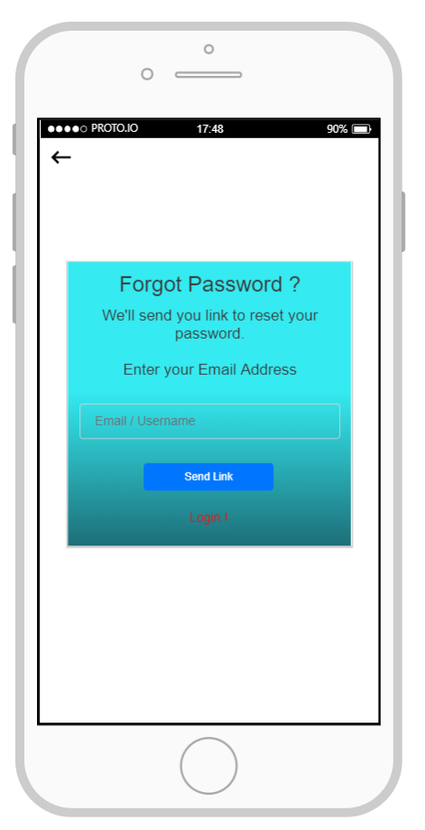
Forgot Password
New password link send on user g-mail account or mobile number.

Slide 7
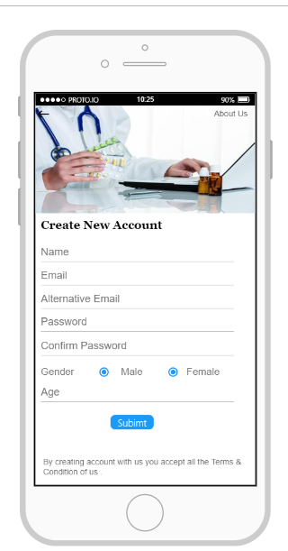
Create new Account
New user Registration Page

Slide 8
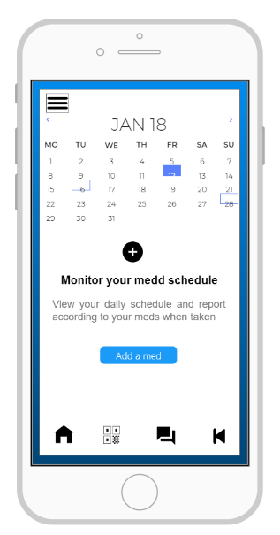
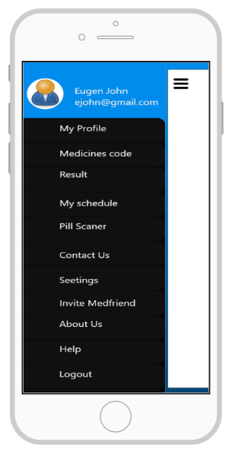
Dashboard

Slide 9
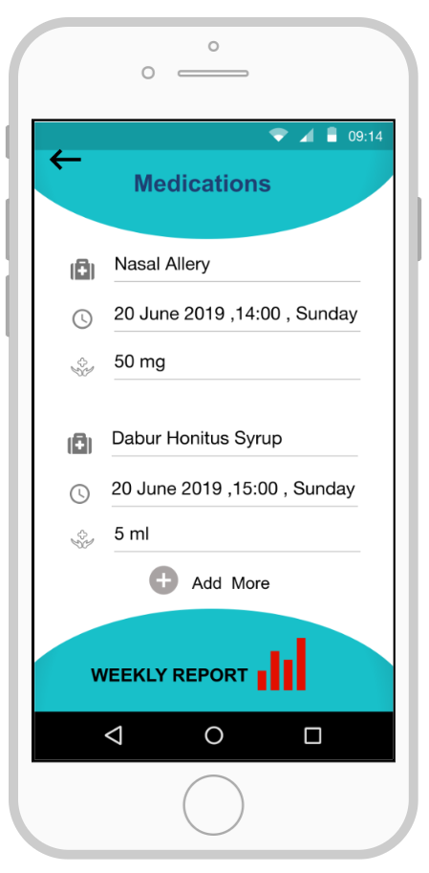
MedProfile
MedProfile of the user which contains medicines name , medicine doses , date and time along with weekly report in form of graph.

Slide 10
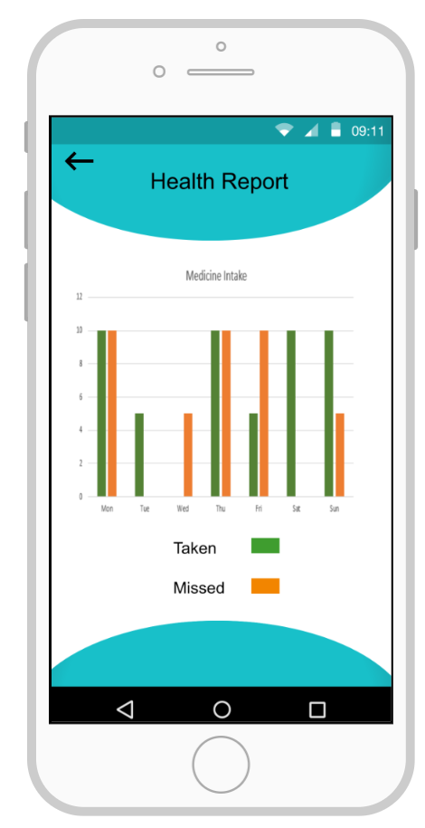
Weekly Report
Weekly report according to medicines intake on time or not.

Slide 11
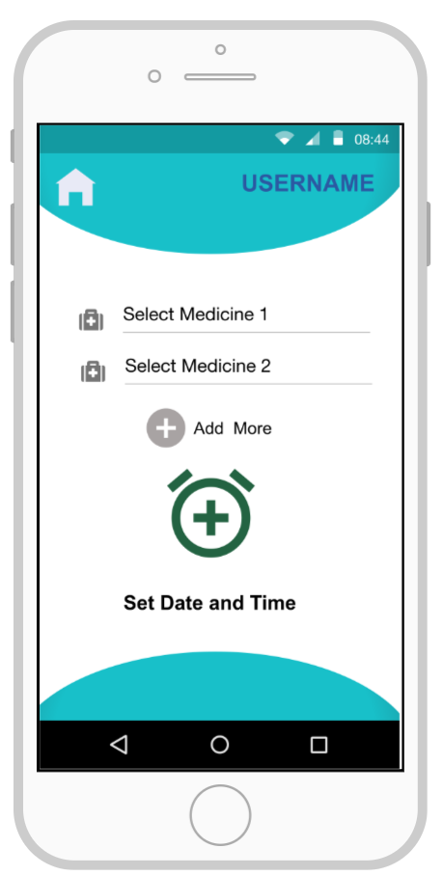
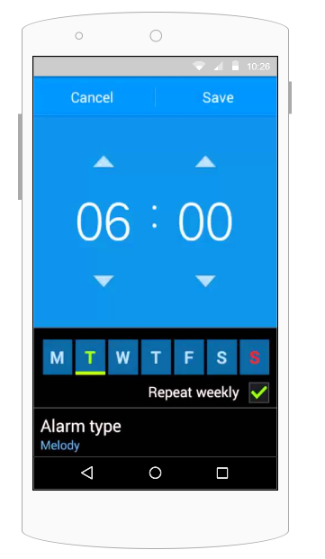
Set date and time

Slide 12
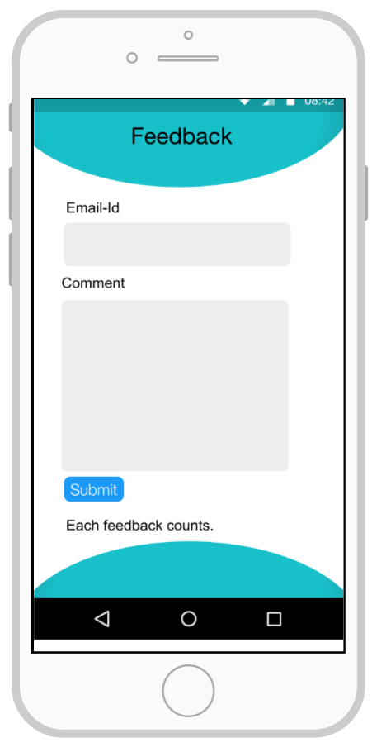
Feedback
Feedback Popup appear when user click on close button.

Slide 13
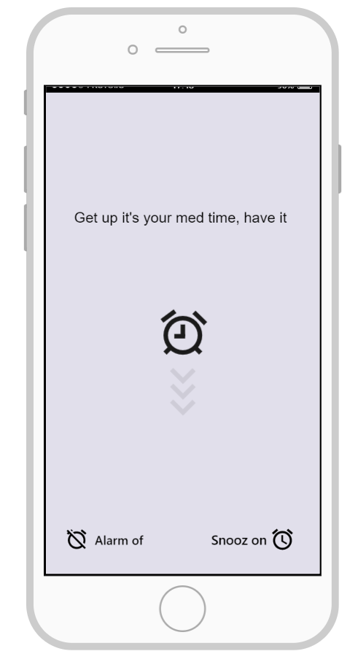
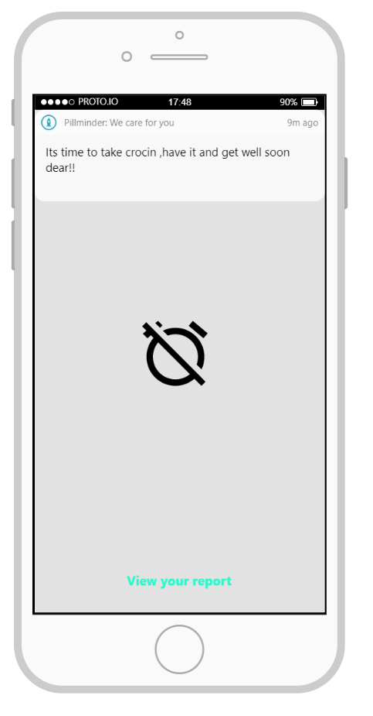
Notification

Slide 14
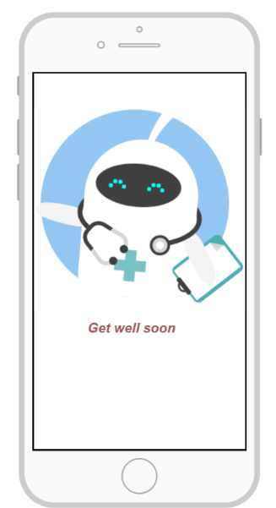
We care you
We are concern for you that’s why we care for you.

Slide 15


